Slide 1
Chapter 3: Processes

Slide 2
Outline
Process Concept
Process Scheduling
Operations on Processes
Interprocess Communication
IPC in Shared-Memory Systems
IPC in Message-Passing Systems
Examples of IPC Systems
Communication in Client-Server Systems

Slide 3
Objectives
Identify the separate components of a process and illustrate how they are represented and scheduled in an operating system.
Describe how processes are created and terminated in an operating system, including developing programs using the appropriate system calls that perform these operations.
Describe and contrast interprocess communication using shared memory and message passing.
Design programs that uses pipes and POSIX shared memory to perform interprocess communication.
Describe client-server communication using sockets and remote procedure calls.
Design kernel modules that interact with the Linux operating system.

Slide 4
Process Concept
An operating system executes a variety of programs that run as a process.
Process – a program in execution; process execution must progress in sequential fashion. No parallel execution of instructions of a single process
Multiple parts
  The program code, also called text section
  Current activity including program counter, processor registers
  Stack containing temporary data
    Function parameters, return addresses, local variables
  Data section containing global variables
  Heap containing memory dynamically allocated during run time

Slide 5
Process Concept (Cont.)
Program is passive entity stored on disk (executable file); process is active
  Program becomes process when an executable file is loaded into memory
Execution of program started via GUI mouse clicks, command line entry of its name, etc.
One program can be several processes
  Consider multiple users executing the same program

Slide 6
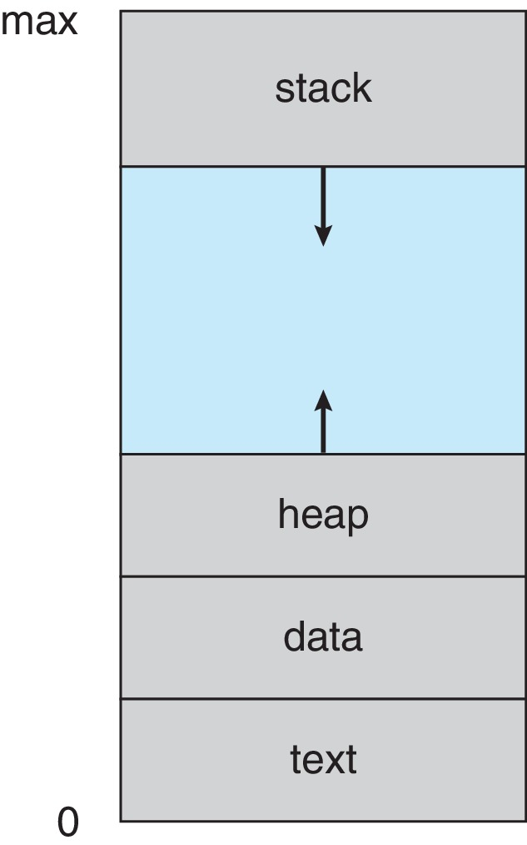
Process in Memory

Slide 7
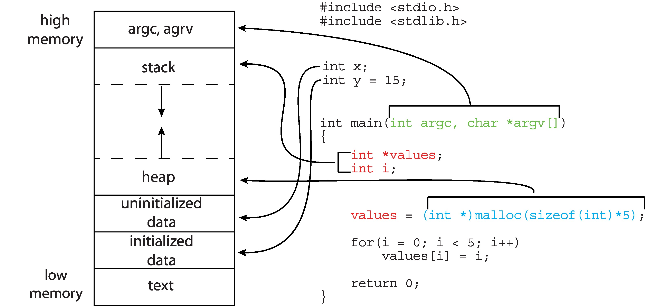
Memory Layout of a C Program

Slide 8
Process State
As a process executes, it changes state
  New: The process is being created
  Running: Instructions are being executed
  Waiting: The process is waiting for some event to occur
  Ready: The process is waiting to be assigned to a processor
  Terminated: The process has finished execution

Slide 9
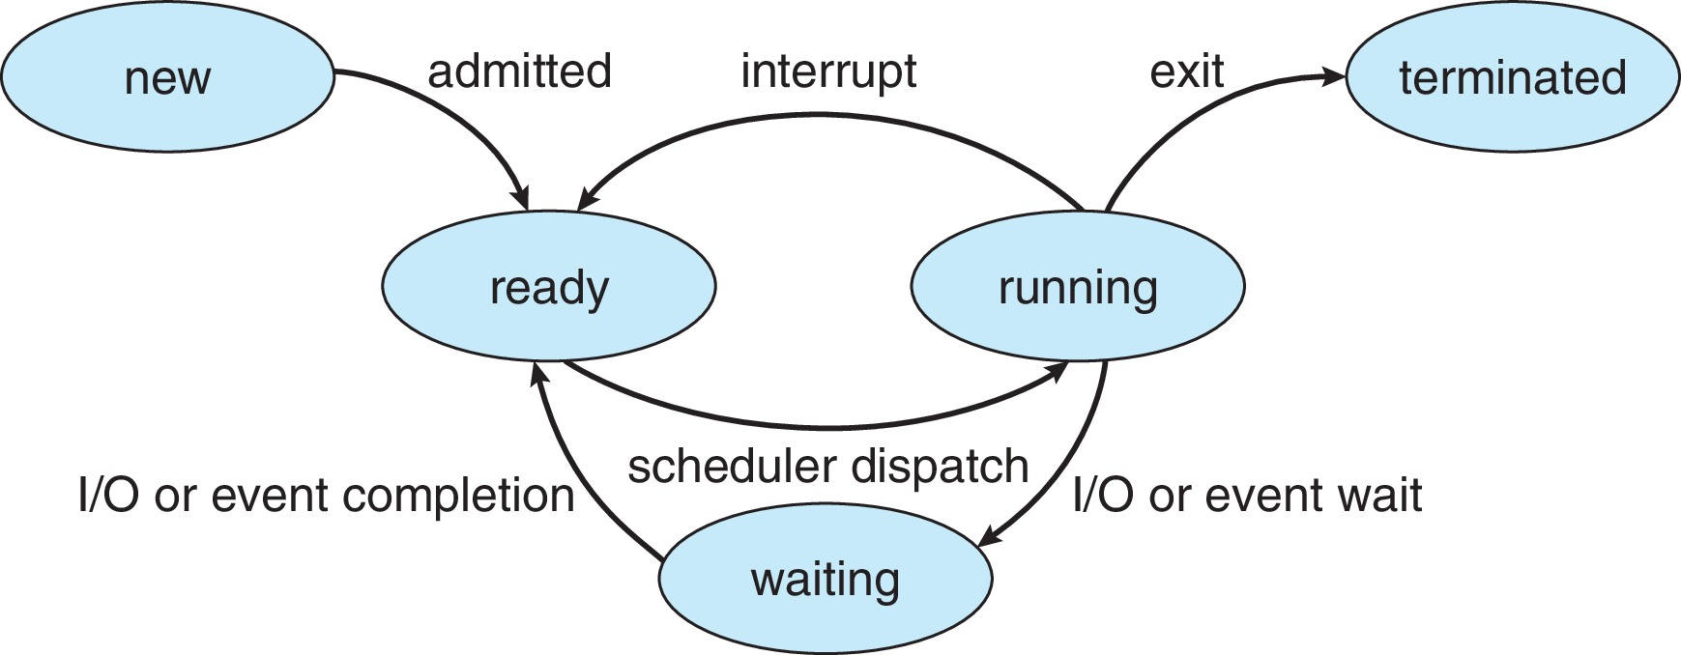
Diagram of Process State

Slide 10
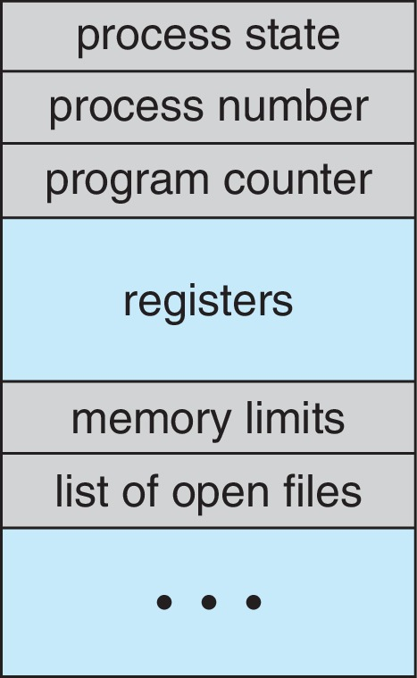
Process Control Block (PCB)
Information associated with each process(also called task control block)
Process state – running, waiting, etc.
Program counter – location of instruction to next execute
CPU registers – contents of all process-centric registers
CPU scheduling information- priorities, scheduling queue pointers
Memory-management information – memory allocated to the process
Accounting information – CPU used, clock time elapsed since start, time limits
I/O status information – I/O devices allocated to process, list of open files

Slide 11
Threads
So far, process has a single thread of execution
Consider having multiple program counters per process
  Multiple locations can execute at once
    Multiple threads of control -> threads
Must then have storage for thread details, multiple program counters in PCB
Explore in detail in Chapter 4

Slide 12
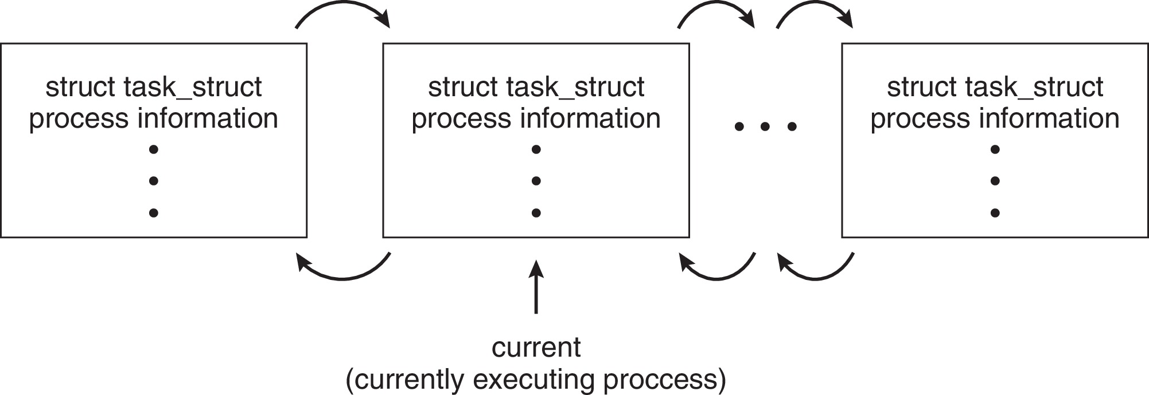
Process Representation in Linux
Represented by the C structure task_struct
pid t_pid; /* process identifier */
long state; /* state of the process */
unsigned int time_slice /* scheduling information */
struct task_struct *parent;/* this process’s parent */
struct list_head children; /* this process’s children */
struct files_struct *files;/* list of open files */
struct mm_struct *mm; /* address space of this process */

Slide 13
Process Scheduling
Process scheduler selects among available processes for next execution on CPU core
Goal -- Maximize CPU use, quickly switch processes onto CPU core
Maintains scheduling queues of processes
  Ready queue – set of all processes residing in main memory, ready and waiting to execute
  Wait queues – set of processes waiting for an event (i.e., I/O)
  Processes migrate among the various queues

Slide 14
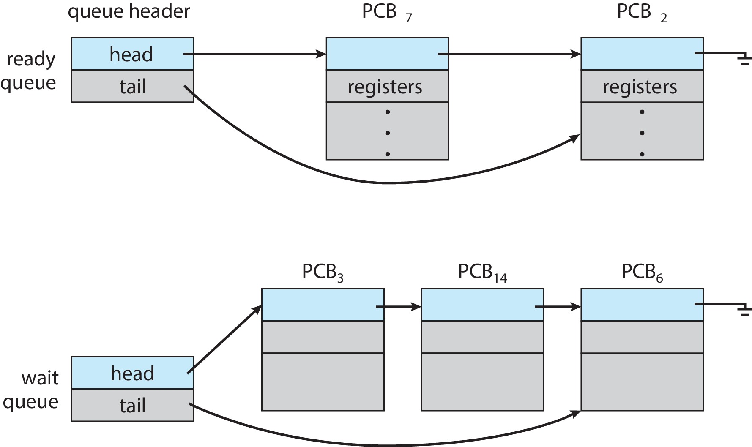
Ready and Wait Queues

Slide 15
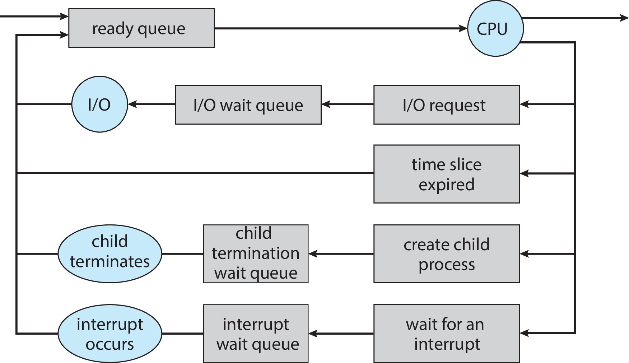
Representation of Process Scheduling

Slide 16
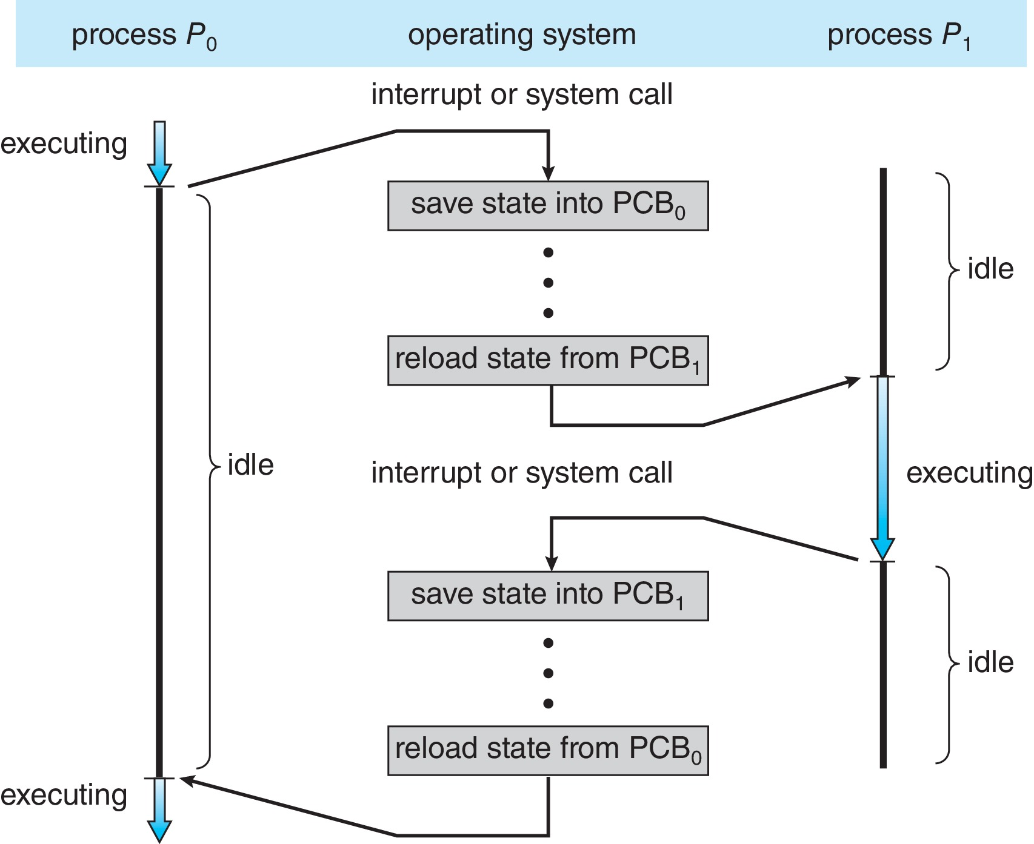
CPU Switch From Process to Process
A context switch occurs when the CPU switches from one process to another.

Slide 17
Context Switch
When CPU switches to another process, the system must save the state of the old process and load the saved state for the new process via a context switch
Context of a process represented in the PCB
Context-switch time is pure overhead; the system does no useful work while switching
  The more complex the OS and the PCB ➔ the longer the context switch
Time dependent on hardware support
  Some hardware provides multiple sets of registers per CPU ➔ multiple contexts loaded at once

Slide 18
Multitasking in Mobile Systems
Some mobile systems (e.g., early version of iOS) allow only one process to run, others suspended
Due to screen real estate, user interface limits iOS provides for a
  Single foreground process- controlled via user interface
  Multiple background processes– in memory, running, but not on the display, and with limits
  Limits include single, short task, receiving notification of events, specific long-running tasks like audio playback
Android runs foreground and background, with fewer limits
  Background process uses a service to perform tasks
  Service can keep running even if background process is suspended
  Service has no user interface, small memory use

Slide 19
Operations on Processes
System must provide mechanisms for:
  Process creation
  Process termination

Slide 20
Process Creation
Parent process create children processes, which, in turn create other processes, forming a tree of processes
Generally, process identified and managed via a process identifier (pid)
Resource sharing options
  Parent and children share all resources
  Children share subset of parent’s resources
  Parent and child share no resources
Execution options
  Parent and children execute concurrently
  Parent waits until children terminate

Slide 21
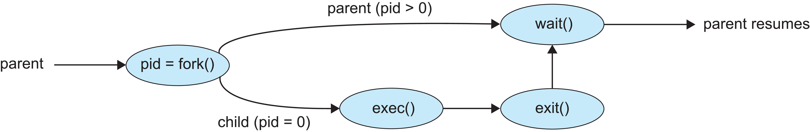
Process Creation (Cont.)
Address space
  Child duplicate of parent
  Child has a program loaded into it
UNIX examples
  fork() system call creates new process
  exec() system call used after a fork() to replace the process’ memory space with a new program
  Parent process calls wait()waiting for the child to terminate

Slide 22
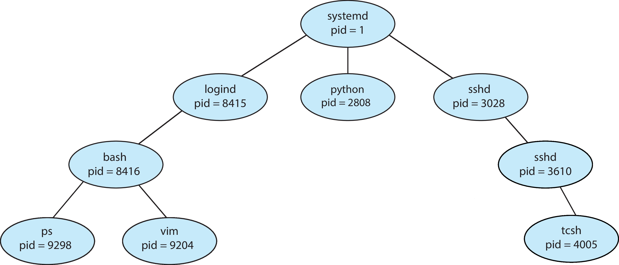
A Tree of Processes in Linux

Slide 23
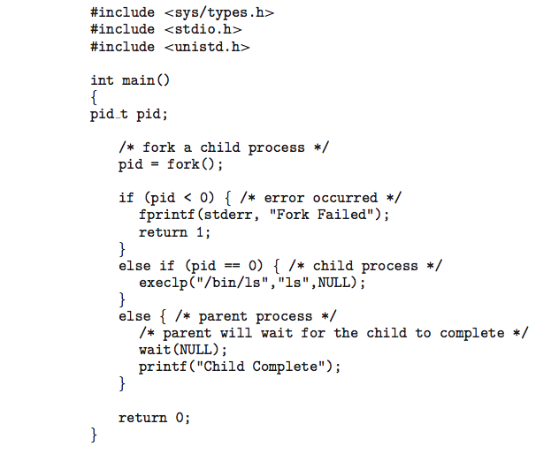
C Program Forking Separate Process

Slide 24
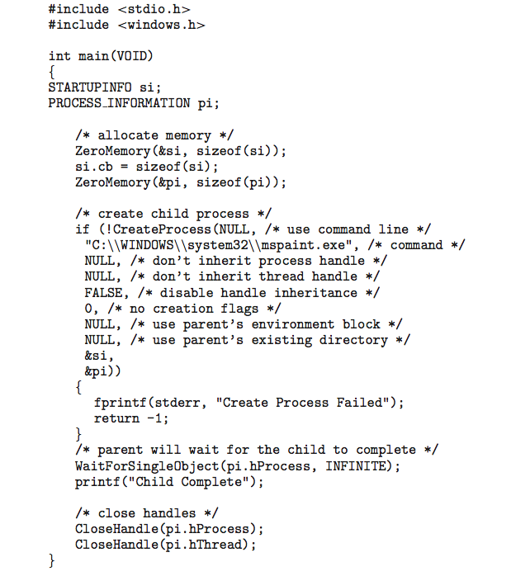
Creating a Separate Process via Windows API

Slide 25
Process Termination
Process executes last statement and then asks the operating system to delete it using the exit() system call.
  Returns status data from child to parent (via wait())
  Process’ resources are deallocated by operating system
Parent may terminate the execution of children processes using the abort() system call. Some reasons for doing so:
  Child has exceeded allocated resources
  Task assigned to child is no longer required
  The parent is exiting, and the operating systems does not allow a child to continue if its parent terminates

Slide 26
Process Termination
Some operating systems do not allow child to exists if its parent has terminated. If a process terminates, then all its children must also be terminated.
  cascading termination. All children, grandchildren, etc., are terminated.
  The termination is initiated by the operating system.
The parent process may wait for termination of a child process by using the wait()system call. The call returns status information and the pid of the terminated process
pid = wait(&status);
If no parent waiting (did not invoke wait()) process is a zombie
If parent terminated without invoking wait(), process is an orphan

Slide 27
Android Process Importance Hierarchy
Mobile operating systems often have to terminate processes to reclaim system resources such as memory. From most to least important:
  Foreground process
  Visible process
  Service process
  Background process
  Empty process
Android will begin terminating processes that are least important.

Slide 28

Multiprocess Architecture – Chrome Browser
Many web browsers ran as single process (some still do)
  If one web site causes trouble, entire browser can hang or crash
Google Chrome Browser is multiprocess with 3 different types of processes:
  Browser process manages user interface, disk and network I/O
  Renderer process renders web pages, deals with HTML, Javascript. A new renderer created for each website opened
    Runs in sandbox restricting disk and network I/O, minimizing effect of security exploits
  Plug-in process for each type of plug-in

Slide 29
Interprocess Communication
Processes within a system may be independent or cooperating
Cooperating process can affect or be affected by other processes, including sharing data
Reasons for cooperating processes:
  Information sharing
  Computation speedup
  Modularity
  Convenience
Cooperating processes need interprocess communication (IPC)
Two models of IPC
  Shared memory
  Message passing

Slide 30
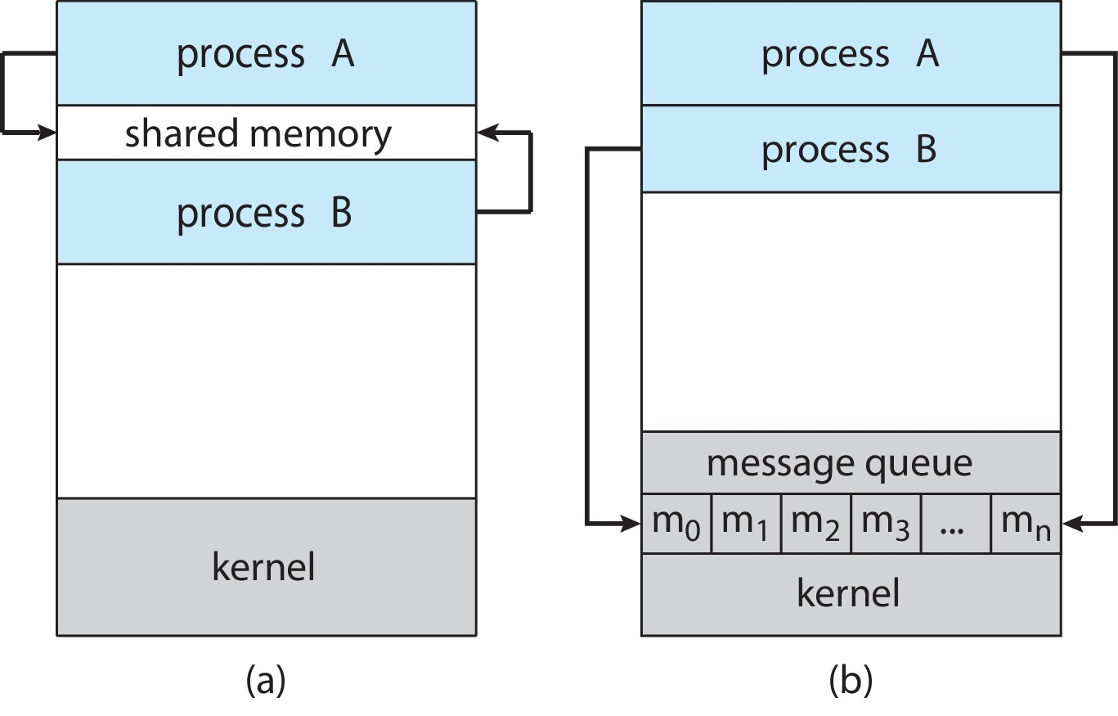
Communications Models
(a) Shared memory. (b) Message passing.

Slide 31
Producer-Consumer Problem
Paradigm for cooperating processes:
  producer process produces information that is consumed by a consumer process
Two variations:
  unbounded-buffer places no practical limit on the size of the buffer:
    Producer never waits
    Consumer waits if there is no buffer to consume
  bounded-buffer assumes that there is a fixed buffer size
    Producer must wait if all buffers are full
    Consumer waits if there is no buffer to consume

Slide 32
IPC – Shared Memory
An area of memory shared among the processes that wish to communicate
The communication is under the control of the users processes not the operating system.
Major issues is to provide mechanism that will allow the user processes to synchronize their actions when they access shared memory.
Synchronization is discussed in great details in Chapters 6 & 7.

Slide 33
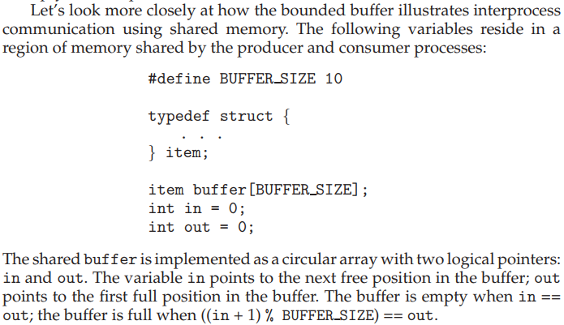
Bounded-Buffer – Shared-Memory Solution

Slide 34
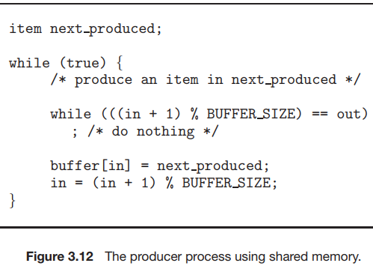
Producer Process – Shared Memory

Slide 35
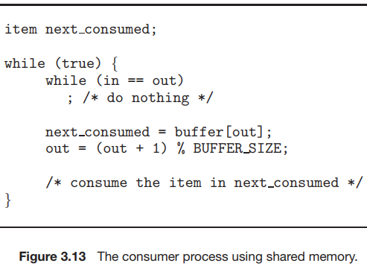
Consumer Process – Shared Memory

Slide 36
Examples of IPC Systems - POSIX
POSIX Shared Memory
  Process first creates shared memory segment
  shm_fd = shm_open(name, O CREAT | O RDWR, 0666);
  Also used to open an existing segment
  Set the size of the object
ftruncate(shm_fd, 4096);
  Use mmap() to memory-map a file pointer to the shared memory object
  Reading and writing to shared memory is done by using the pointer returned by mmap().

Slide 37
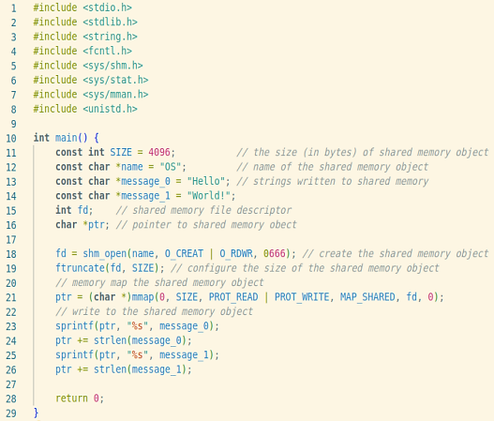

IPC POSIX Producer

Slide 38
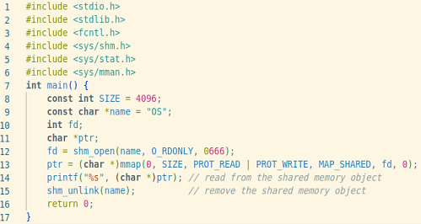
IPC POSIX Consumer

Slide 39
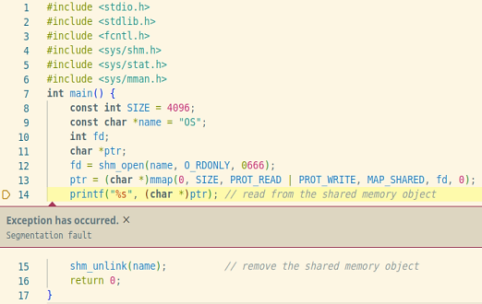
IPC POSIX Consumer

Slide 40
Pipes
Acts as a conduit allowing two processes to communicate
Issues:
  Is communication unidirectional or bidirectional?
  In the case of two-way communication, is it half or full-duplex?
  Must there exist a relationship (i.e., parent-child) between the communicating processes?
  Can the pipes be used over a network?
Ordinary pipes – cannot be accessed from outside the process that created it. Typically, a parent process creates a pipe and uses it to communicate with a child process that it created.
Named pipes – can be accessed without a parent-child relationship.

Slide 41
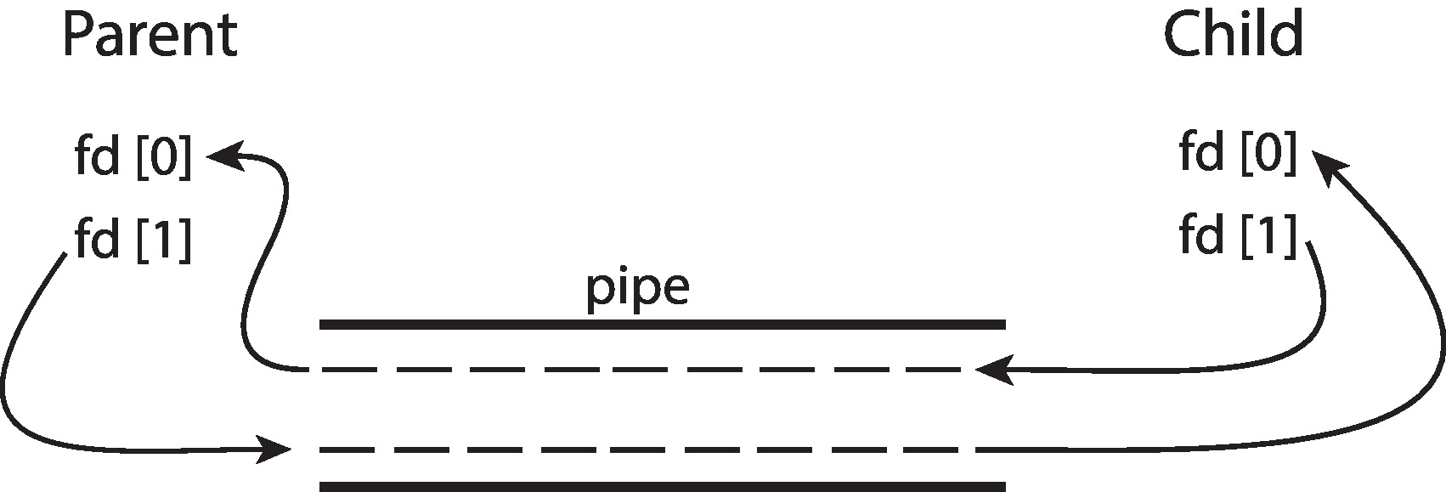
Ordinary Pipes
Ordinary Pipes allow communication in standard producer-consumer style
Producer writes to one end (the write-end of the pipe)
Consumer reads from the other end (the read-end of the pipe)
Ordinary pipes are therefore unidirectional
Require parent-child relationship between communicating processes
Windows calls these anonymous pipes

Slide 42
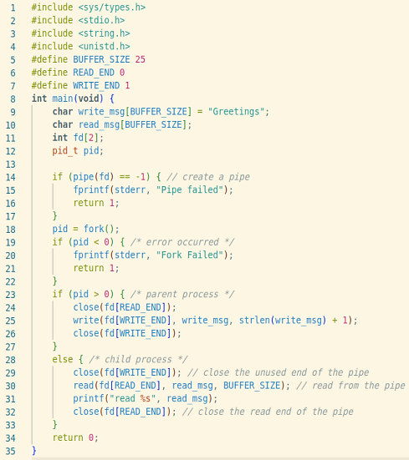
Ordinary Pipes

Slide 43
Named Pipes
Named Pipes are more powerful than ordinary pipes
Communication is bidirectional
No parent-child relationship is necessary between the communicating processes
Several processes can use the named pipe for communication
Provided on both UNIX and Windows systems

Slide 44
Named Pipes (FIFOs)
Persistence: They are stored as files in the file system and can be accessed by any process as long as they have the necessary permissions. Unrelated processes can communicate using them.
Bidirectional Communication: Multiple processes can write to and read from the same named pipe. Pipes are unidirectional.
Synchronization: Named pipes provide a natural synchronization mechanism. Processes can block when reading from an empty pipe or writing to a full pipe, allowing them to synchronize their activities effectively.
Multiple Readers/Writers: Named pipes allow multiple processes to read from or write to the pipe simultaneously. This feature enables more flexible communication patterns and can be useful in scenarios where multiple processes need to access the same data concurrently.

Slide 45
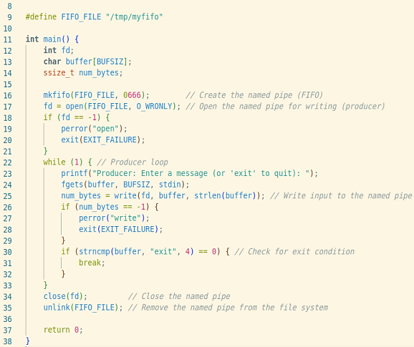
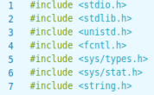
Named Pipes

Slide 46
End of Chapter 3

